Slide 1

Welcome session
2022
Notes:
Bienvenue au CERN, welcome to CERN.
Pour rappel, cette présentation est destinée uniquement aux Staff, boursiers et étudiants.
As a reminder, this presentation is only for Staff, fellows and students.

Slide 2





Key informations
Insurer
CERN Health Insurance Scheme
Contributions 2022: 12.69% ► 4,86% of Member’s monthly remuneration ► 7,83% CERN CHIS is a mutual system based on solidarity among Members: the amount of the contribution to the CHIS is not based on the composition of the family, age or medical condition of the insured persons, it is rather in proportion to income. Thus, everyone contributes according to his/her means and makes use of the cover according to his/her needs.
Third-party administrator
Contract with CERN for the day-to-day administration of the CHIS
2022
Notes:
Thus, everyone contributes according to his/her means and makes use of the cover according to his/her needs.
Freedom
CHIS Members benefit not only from a worldwide valid cover but also from freedom of choice of health care providers (doctors, hospitals, clinics).
Responsibility
The freedom, however, is not without limits. The CHIS is a self-financed system. Accordingly, the level of reimbursement shall not exceed the level of contributions. Should this happen, an increase in the contributions would be necessary.
Therefore, CHIS Members are invited to contribute actively to the Scheme's cost-containment policy. Keeping costs under control is the addition of individual actions which help to maintain the financial balance of the Scheme and thus to contain any possible increase in contributions.

Slide 3


Membership
Compulsory for :
► Staff members and fellows
► Students: Tech, Doc, Admin
Starts automatically on the 1st day of:
the employment contract
the partnership/ marriage
life for child!
Finishes automatically on the last day of:
the employment contract,
the partnership/ marriage.
Membership of any family member (as defined in Article S IV 1.02 of the Staff Regulations and Rules) is compulsory and automatic and the coverage is the same as the main Member.
Any change in family status must be declared to the Organization.
Spouses
► Spouses with no other health insurance: CHIS serves as primary health insurance, and a monthly additional contribution may be payable according to their gross monthly income.
► Spouses with an other health insurance (recognised by CERN): CHIS serves as supplementary health insurance without supplementary contribution.
2022

Slide 4

► For Staff members, Fellows and Students:
- Cancel your health insurance (national or not) with a certificate of insurance to be requested to UNIQA.
- Return your insurance cards and do not use them anymore.
► For Staff members and Fellows only who have a spouse:
(Students who have a spouse are not required to complete a SHIPID)
Complete a SHIPID (Spouse Health Insurance and Professional Income Declaration) form in EDH to declare your spouse’s status.
Then any change in the spouse's gross income or health insurance situation must be declared to the Organization.
Special attention for people who want to settle in Switzerland or who are already settled in Switzerland.
Your family members are automatically and compulsorily affiliated to the CHIS. However, this does not necessarily dispense them from their obligations under Swiss law deriving from the fact that they reside or are taking up residence in Switzerland. This applies whether they have Swiss nationality or hold a B-or C-type residence permit. In such cases, they become or remain subject to the obligation to contract insurance cover in Switzerland with a LAMal insurance provider, unless they apply for exemption.
You have 3 months to apply for the exemption.
On arrival
2022

Slide 5

Health Insurance Benefits
► Health coverage is worldwide
► List of benefits, details of reimbursement rates and expenditure ceilings can be found in Annex I of the CHIS Rules.
► Reimbursement rate under the General Rule
► Reimbursement Bonus
If you go to France or in one the CERN Member States (all, except Denmark, Norway and Switzerland) to see a doctor, buy medication, have tests or scans, you will be reimbursed 85% of the costs instead of 80% or 95% instead of 90%.
► Reimbursement of medical expenses
You pay the health care provider first then you send your medical bills with the proof of payment to UNIQA who then reimburses you.
There is no third-party payment except for hospitalization in public and agreed private hospitals
Cumulated Costs Borne by the Member (FCA) | Reimbursement rate
up to 500 CHF inclusive | 80%
over 500 CHF, up to 3 000 CHF inclusive | 90%
3 000 CHF | 100%
Type | CHIS approval | Ward | Reimbursement rate | Maximum FCA | Method of payment of invoice
Public | Always approved | Public | 100% | 0 CHF | Paid directly by the TPA
 |  | Private or semi-private | General Rule (80%,90% or 100% depending on the annual FCA) | 3000 CHF | Paid directly by the TPA
Private | Approved | All wards | General Rule (80%,90% or 100% depending on the annual FCA) | 3000 CHF | Paid directly by the TPA
 | Unapproved | All wards | 80% | Unlimited | Paid by the Member
2022

Slide 6
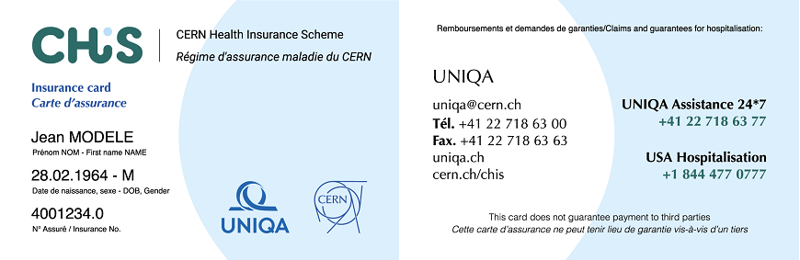
How to send your medical bills for reimbursement?
To claim and follow reimbursements, periodic statements, cards and insurance certificates, go to:
► MYUNIQA.CH (Please wait 15 days before creating your account)
Your insurance number is your CERNid followed by .0 = Principal Member (xxxxxx.0)
Claim reimbursement up to 12 months after the date of issue of the invoice.
You will receive your insurance card within 15-20 days.
2022

Slide 7

Who to contact for what ?
To be contacted for any question or request regarding SHIPID or experiences with TPA
SHIPID Service Chis.shipid @cern.ch CHIS Manager chis.manager@cern.ch ► CHIS Website: chis.cern General information, procedures, forms, CHIS Rules and other official documents, FAQ…
To be contacted for any question or request regarding :
your cover and your benefits; your spouse's and children's cover and benefits; your claims and reimbursements; membership cards and insurance certificates; the approved hospitals and health care providers in general; the application of the CHIS Rules. ► UNIQA uniqa@cern.ch or +41 (0)22 718 63 00
2022
Notes:
CERN a sa propre assurance santé. Système de solidarité ou chacun contribue en fonction de ses besoins
CHIS is not a private insurance, it is a Mutual system to which both the Organization and those insured contribute.
3 principles :
Mutuality
Mutuality is based on solidarity among Members. Indeed, the amount of the contribution to the CHIS is not determined by family situation, age or medical condition of the insured persons. It is rather in proportion to income, except in cases of voluntary affiliation.
Thus, everyone contributes according to his/her means and makes use of the cover according to his/her needs.
Freedom
CHIS Members benefit not only from a worldwide valid cover but also from freedom of choice of health care providers (doctors, hospitals, clinics).
Responsibility
The freedom, however, is not without limits. The CHIS is a self-financed system. Accordingly, the level of reimbursement shall not exceed the level of contributions. Should this happen, an increase in the contributions would be necessary.
Therefore, CHIS Members are invited to contribute actively to the Scheme's cost-containment policy. Keeping costs under control is the addition of individual actions which help to maintain the financial balance of the Scheme and thus to contain any possible increase in contributions.

Slide 8

THANK YOU !
2022

