Slide 1



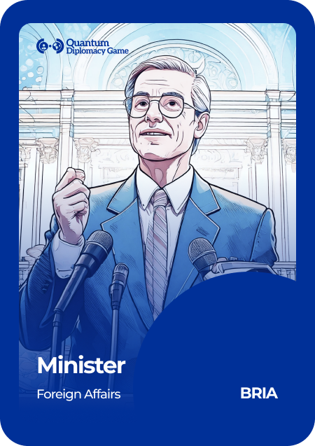
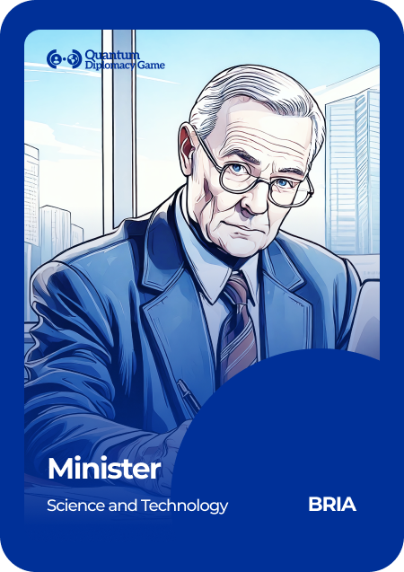
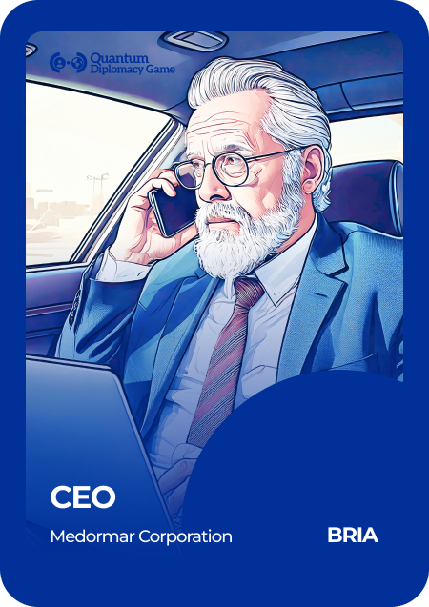

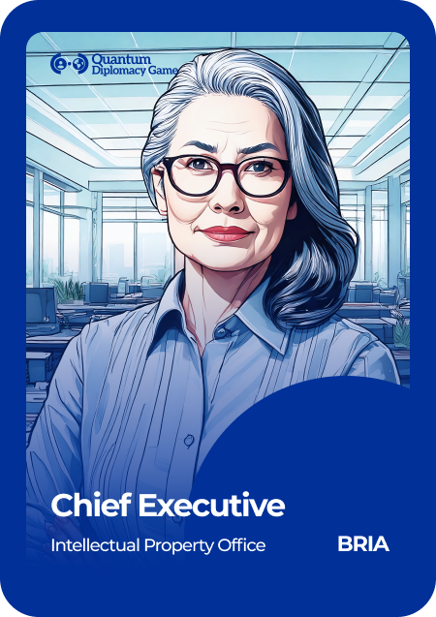
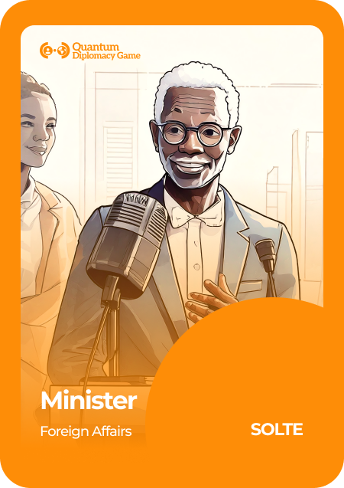


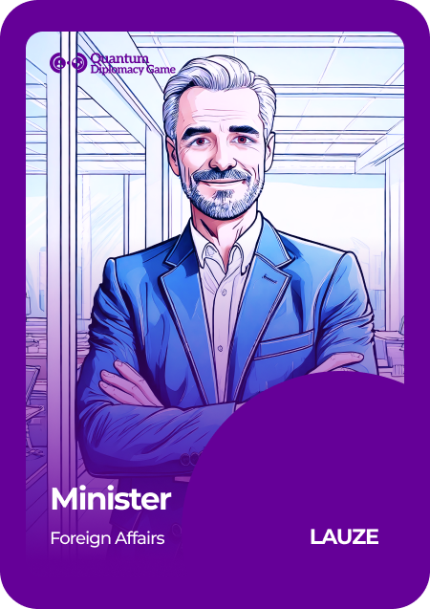
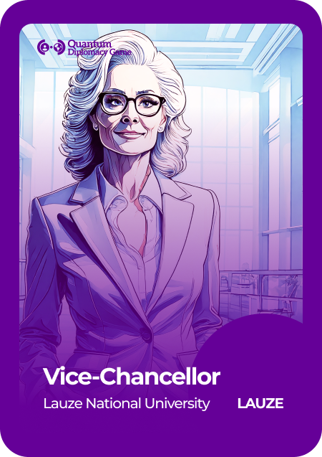

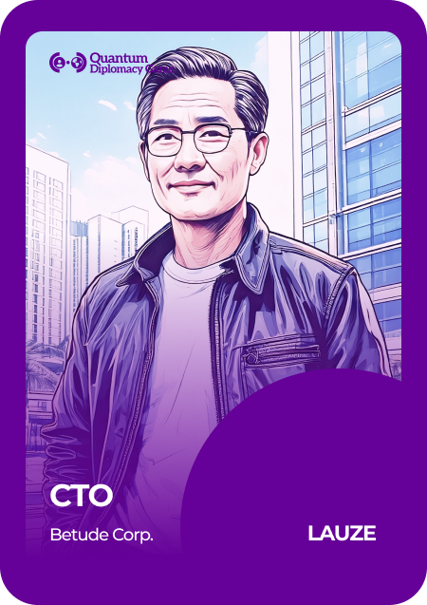

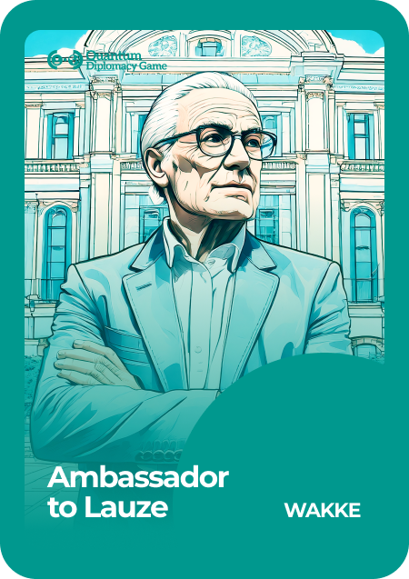


Geneva Science and
Diplomacy Anticipator Foundation
Characters that can be played in pairs
If you need to double some roles, we recommend the following (sorted by priority):
UNESCO Policy Lead = CHAIR
WAKKE Managing Director (NGO voice)
Voices from Academia
  SOLLTE Professor of Human-Centred Technology
  LAUZE Vice Chancellor
  BRIA Head of Department of Physics
  4) Voices from Industry: LAUZE CTO
Bria
Solte
UNESCO
Wakke
Lauze

