Slide 1



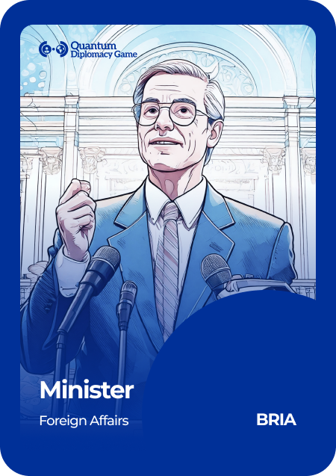
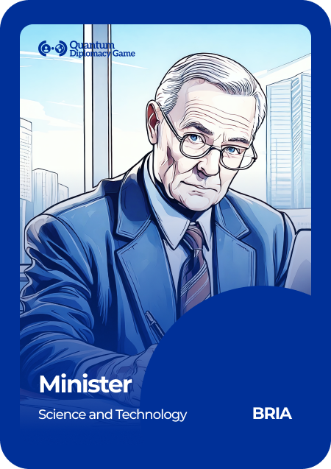






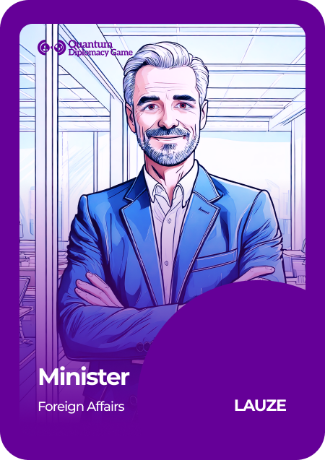
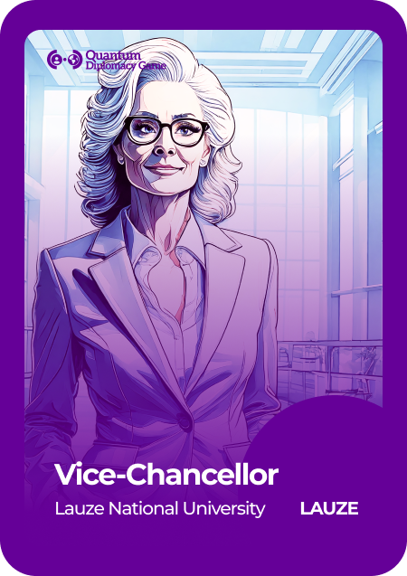






Geneva Science and
Diplomacy Anticipator Foundation
Seating Order at the Symposium
Solte
Bria
UNESCO
Wakke
Lauze

