Slide 1





THE GENEVA SCIENCE AND DIPLOMACY ANTICIPATOR USE THE FUTURE TO BUILD THE PRESENT
Geneva Science and
Diplomacy Anticipator Foundation
Name of your Event

Slide 2

THE GENEVA SCIENCE AND DIPLOMACY ANTICIPATOR USE THE FUTURE TO BUILD THE PRESENT
Geneva Science and
Diplomacy Anticipator Foundation
Anticipate scientific breakthroughs

Slide 3
THE GENEVA SCIENCE AND DIPLOMACY ANTICIPATOR USE THE FUTURE TO BUILD THE PRESENT
Geneva Science and
Diplomacy Anticipator Foundation
Agenda
Introduction
- Introducing | the GESDA Science | Breakthrough Radar
- The Quantum | Diplomacy Game in | a nutshell
Seeing the future
Using the future to build the present Debriefing
- Navigating a new area marked by science breakthroughs and geopolitical tensions

Slide 4
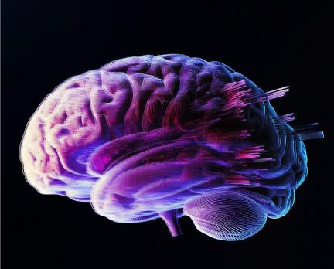
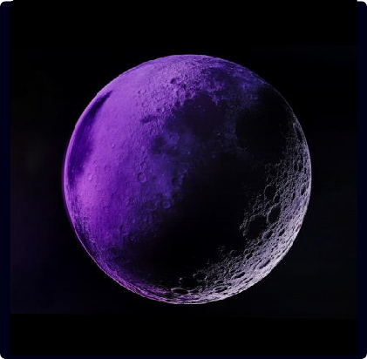
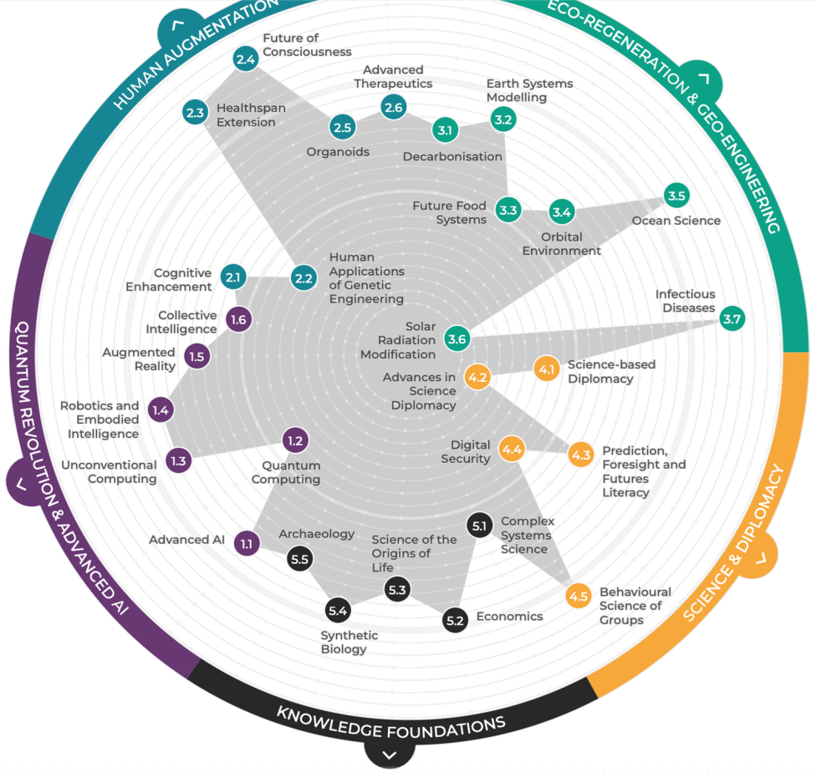
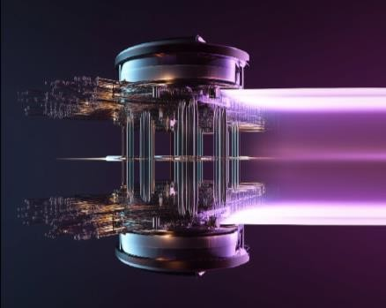
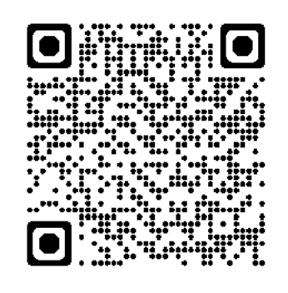
The GESDA Science Breakthrough
THE GENEVA SCIENCE AND DIPLOMACY ANTICIPATOR USE THE FUTURE TO BUILD THE PRESENT
Geneva Science and
Diplomacy Anticipator Foundation
Radar®
2100+
scientists from
87 countries
in 10 years …
Orbital environment
lunar habitation approaches
ECO-REGENERATION & GEO-ENGINEERING
HUMAN
AUGMENTATION
Cognitive enhancement implants enhance cognition through exogenous AI
QUANTUM REVOLUTION & ADVANCED AI
not science fiction but possible futures in 5, 10, 25
in 5 years …
Quantum Computing
early breakthroughs in material science and drug discovery
years
SCIENCE & DIPLOMACY
KNOWLEDGE
FOUNDATIONS

Slide 5

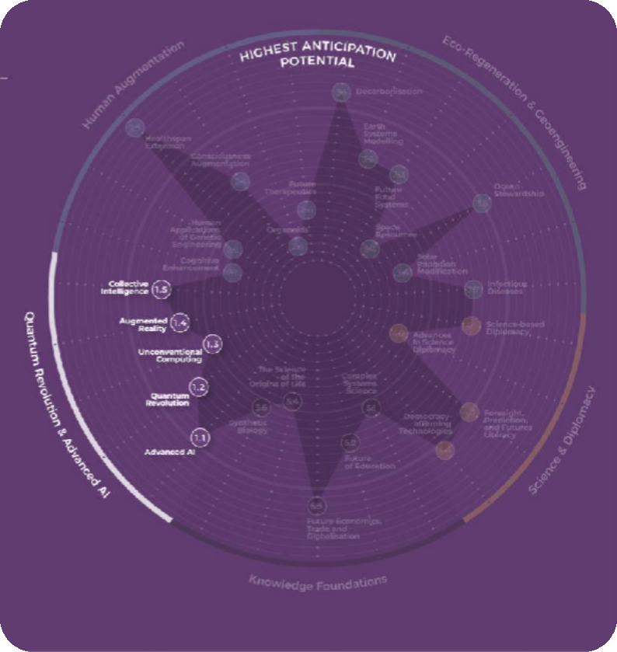
THE GENEVA SCIENCE AND DIPLOMACY ANTICIPATOR USE THE FUTURE TO BUILD THE PRESENT
Geneva Science and
Diplomacy Anticipator Foundation
TREND:
1
Quantum Revolution & Advanced AI
Quantum computing is coming of age. It is world of probabilities rather than clear cause and effect.
The ecosystem is getting bigger and stronger.
Quantum computing hardware is developing, but
still far away from scalable devices.
To date, no useful quantum advantage has been shown in practice, but progress has been faster than expected.

Slide 6
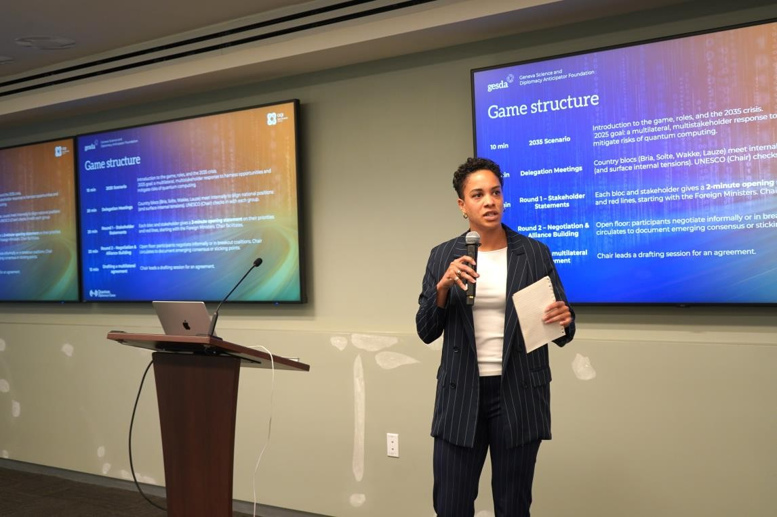
The Quantum Diplomacy Game
THE GENEVA SCIENCE AND DIPLOMACY ANTICIPATOR USE THE FUTURE TO BUILD THE PRESENT
Geneva Science and
Diplomacy Anticipator Foundation
Collectively fostering international collaboration, education, and anticipatory governance in the emerging field of quantum technologies.
1
Collaborative events with diplomatic community, including Swiss embassies around the world.
2
Game embedded in Quantum Diplomacy events at institutions such as ITU, CERN, the World Bank.
3
Contributions to global forums like the International Quantum Forum
4
Complementing regional quantum ecosystem events like QISTcon.ph to advance global dialogue on quantum diplomacy.
QISTCon.ph, 31 July 2025

Slide 7
THE GENEVA SCIENCE AND DIPLOMACY ANTICIPATOR USE THE FUTURE TO BUILD THE PRESENT
Geneva Science and
Diplomacy Anticipator Foundation
Anticipate scientific breakthroughs

Slide 8



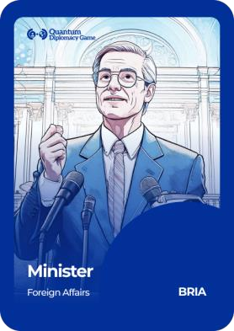
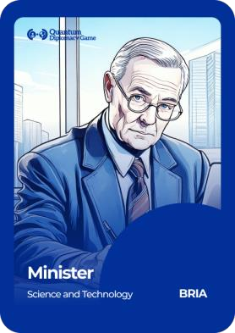

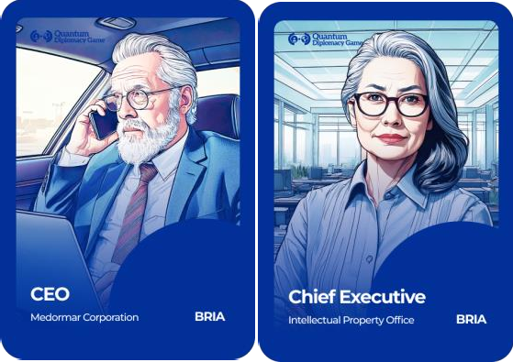
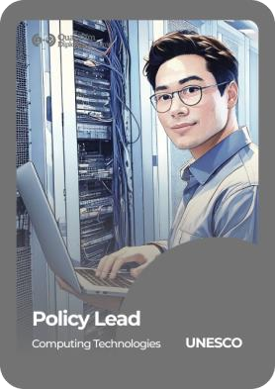
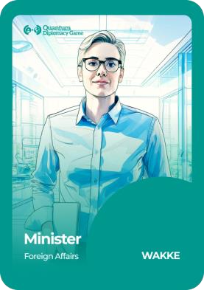
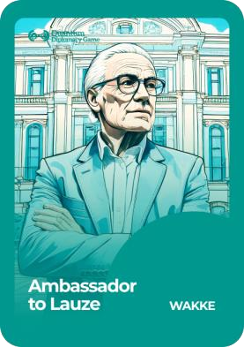

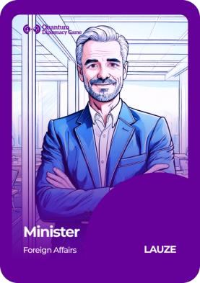


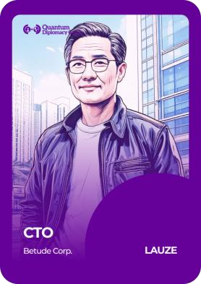
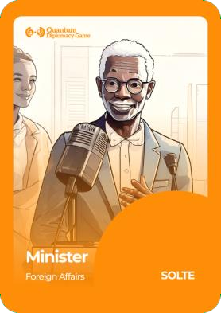
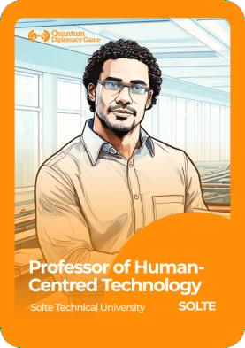
THE GENEVA SCIENCE AND DIPLOMACY ANTICIPATOR USE THE FUTURE TO BUILD THE PRESENT
Geneva Science and
Diplomacy Anticipator Foundation
UNESCO
Bria
Wakke
Lauze
Solte

Slide 9
THE GENEVA SCIENCE AND DIPLOMACY ANTICIPATOR USE THE FUTURE TO BUILD THE PRESENT
Geneva Science and
Diplomacy Anticipator Foundation
Seeing the future

Slide 10


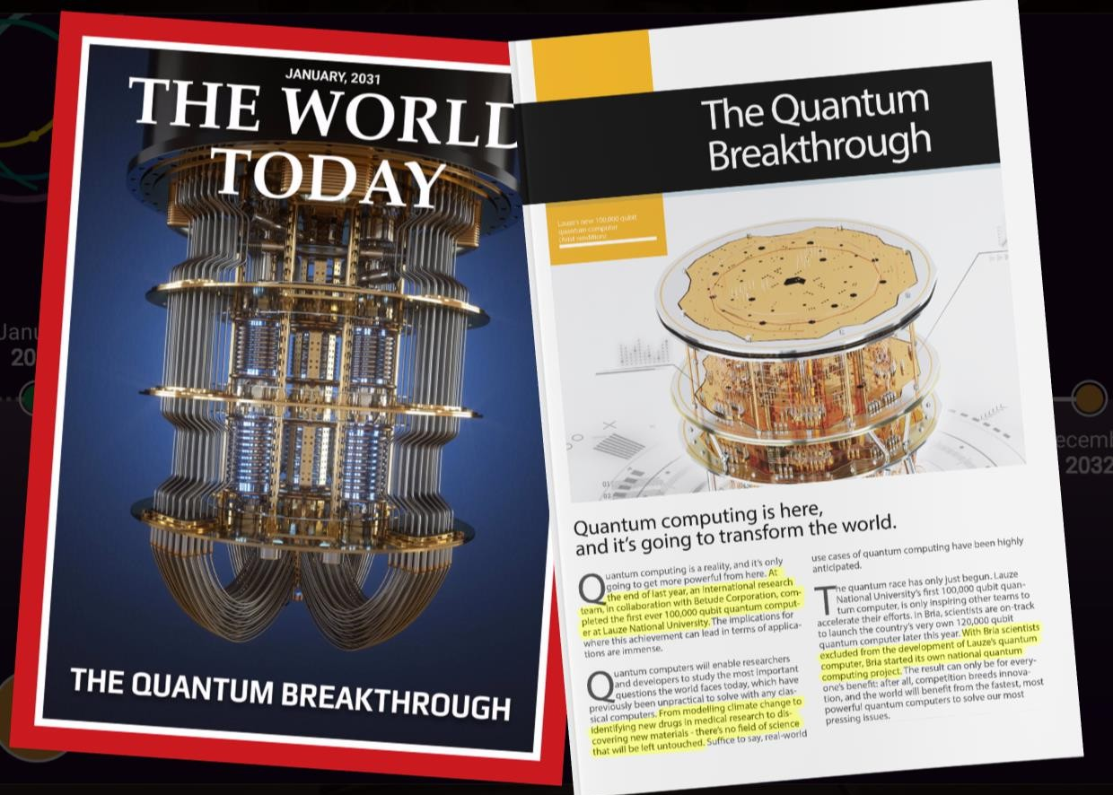



Geneva Science and
Diplomacy Anticipator Foundation
Structure of the_{H}g_{o}a_{w}me_{did we get there?}
SDW | 13.06
January
2034
Februar
y
2035
July
2035
November
2035
March
2034
May
2035
August
2035
December
2035

Slide 11


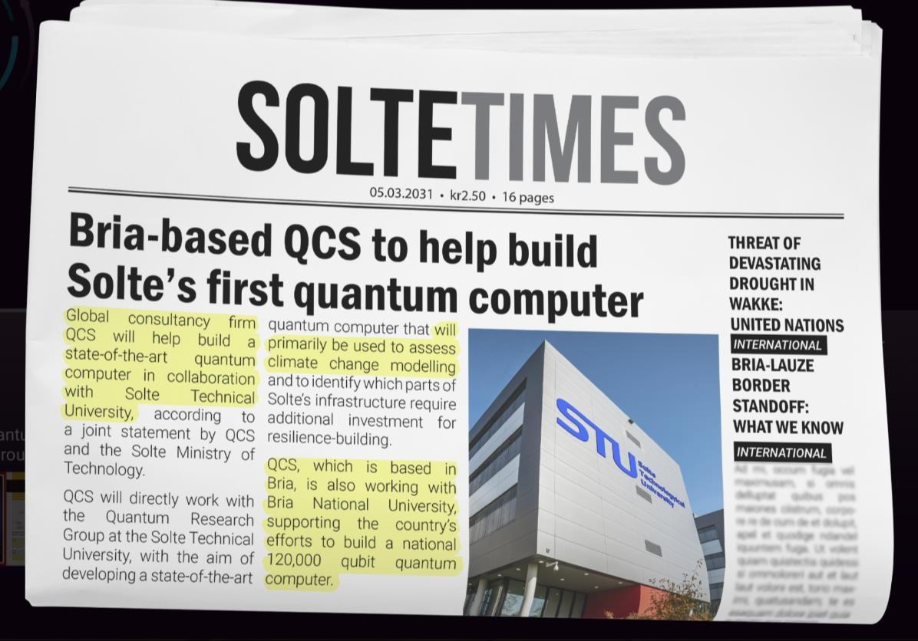

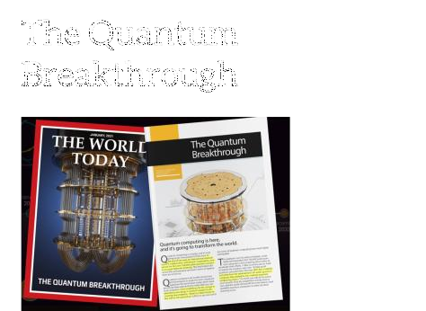
Geneva Science and
Diplomacy Anticipator Foundation
January
2034
Februar y
2035
July
2035
November
2035
March
2034
May
2035
August
2035
December
2035
SDW | 13.06

Slide 12


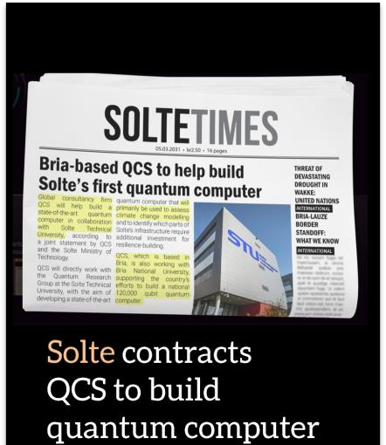
Geneva Science and
Diplomacy Anticipator Foundation
Structure of the_{H}g_{o}a_{w}m_{d}e_{id we get there?}
SDW | 13.06
January
2034
Februar
y
2035
July
2035
November
2035
March
2034
May
2035
August
2035
December
2035

Slide 13
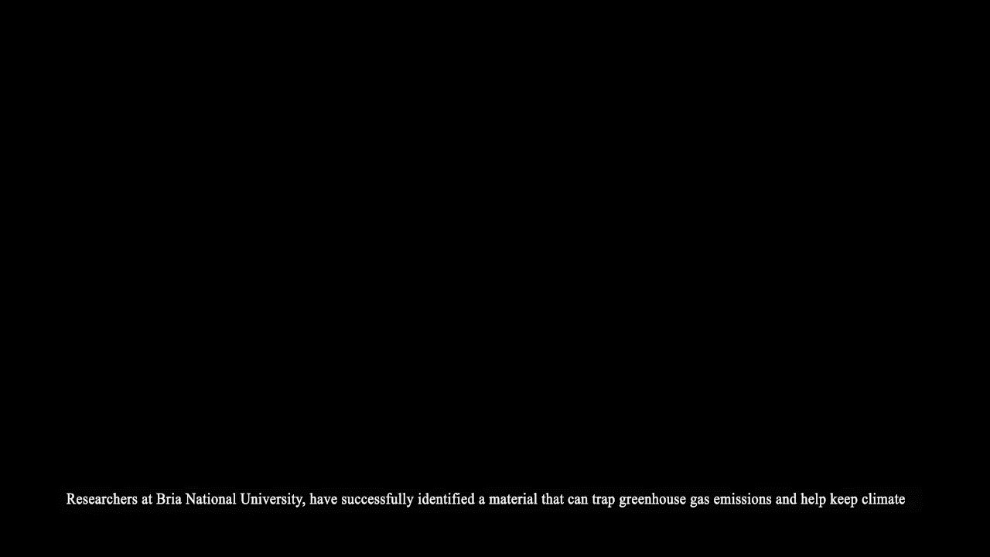
Geneva Science and
Diplomacy Anticipator Foundation
13 SDW | 13.06

Slide 14


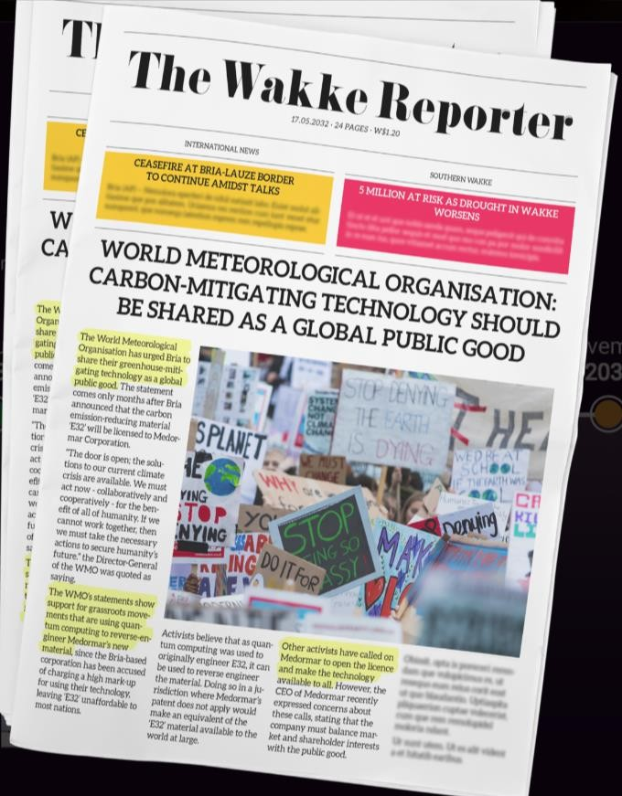

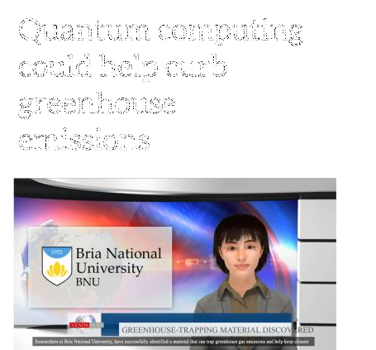
Geneva Science and
Diplomacy Anticipator Foundation
Structure of the_{H}g_{o}a_{w}me_{did we get there?}
SDW | 13.06
January
2034
Februar
y
2035
July Novembe
2035 2035
May August
2035 2035
r
March
2034
December
2035

Slide 15
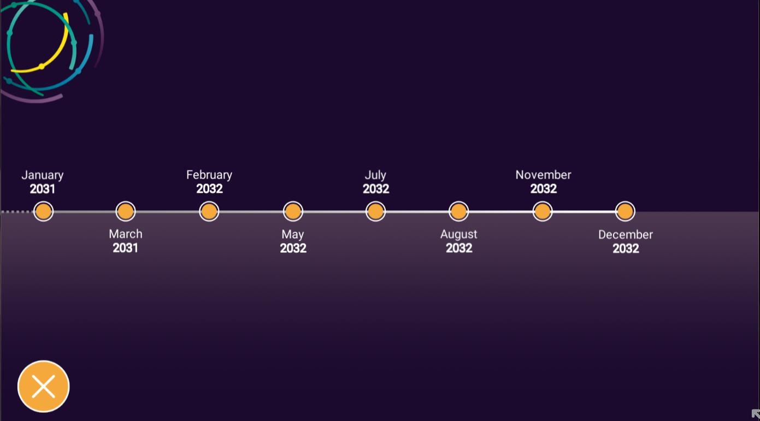


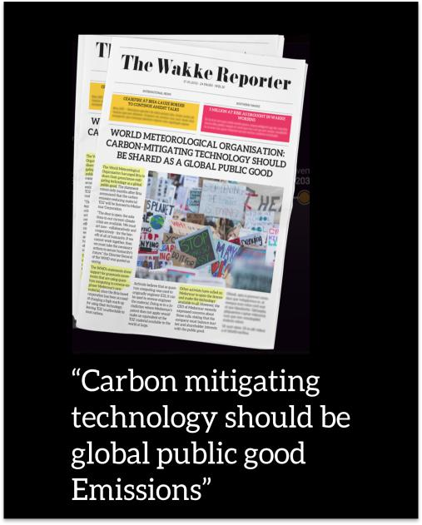
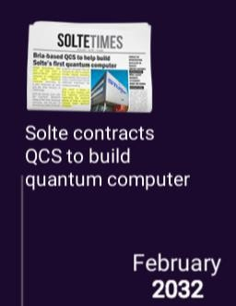


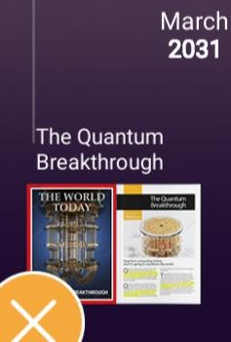

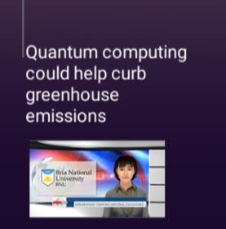
Structure of the_{H}g_{o}a_{w}me_{did we get there?}
Geneva Science and
Diplomacy Anticipator Foundation
Structure of the game
SDW | 13.06
January
2034
Februar y
2035
July
2035
November
2035
March
2034
May
2035
August
2035
December
2035

Slide 16

Geneva Science and
Diplomacy Anticipator Foundation
16 SDW | 13.06

Slide 17


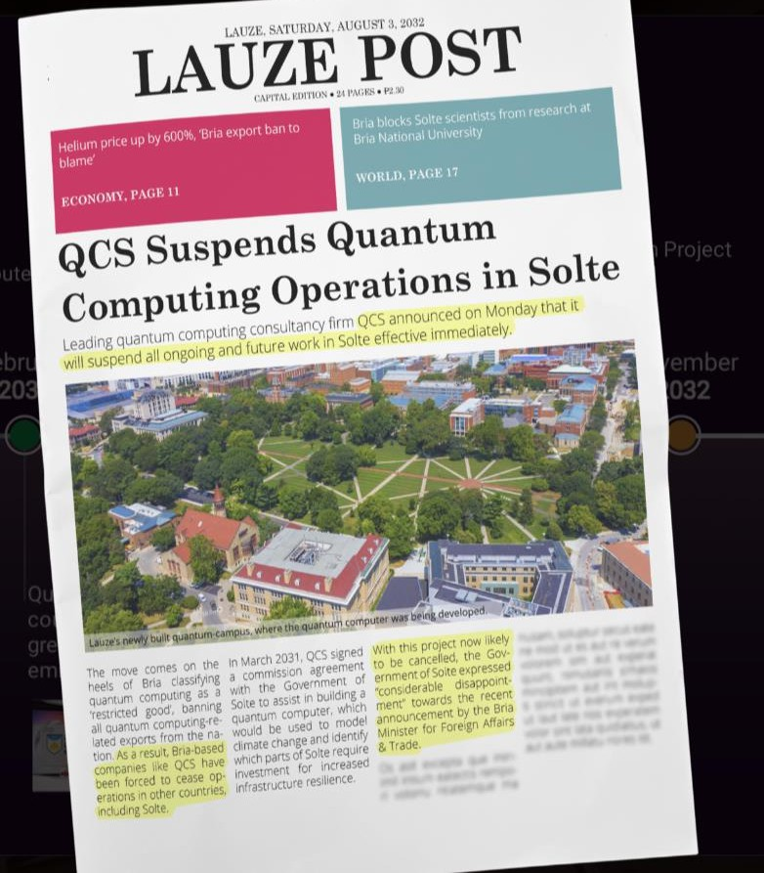
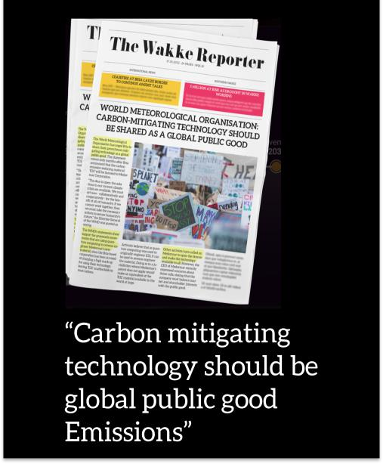

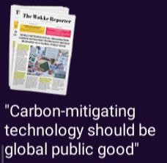


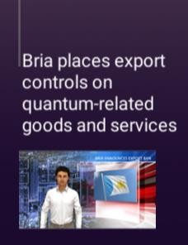
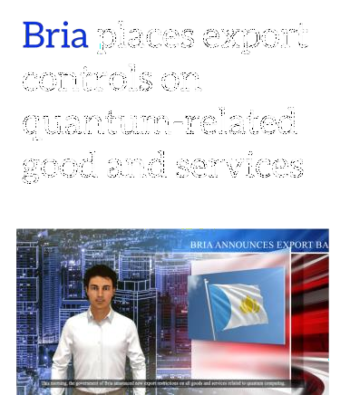
Structure of the_{HH}g_{oo}a_{ww}meddiidd wwee ggeett tthheerree??
SDW | 13.06
Geneva Science and
Diplomacy Anticipator Foundation
January
2034
Februar y
2035
July
2035
November
2035
March
2034
May
2035
August
2035
December
2035

Slide 18


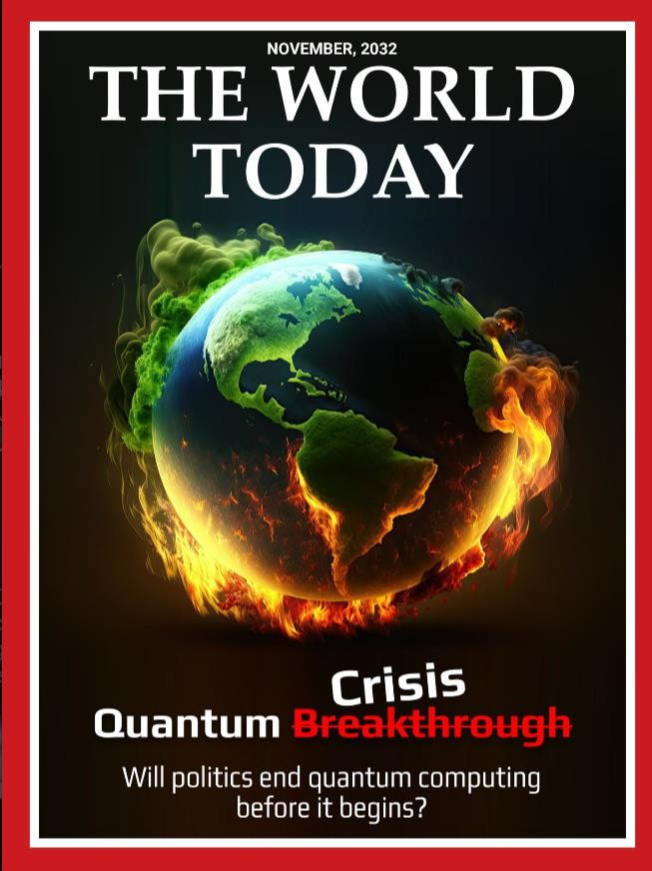
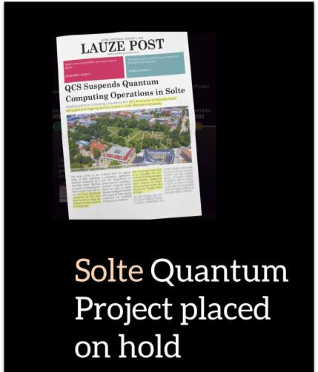
Geneva Science and
Diplomacy Anticipator Foundation
SSttrruuccttuurreeoofftthheeggaammee
How did we get there?
SDW | 13.06
NOVEMBER, 2035
January
2034
Februa y
2035
r July Nov
2035 2
May August
2035 2035
ember
035
March
2034
December
2035

Slide 19

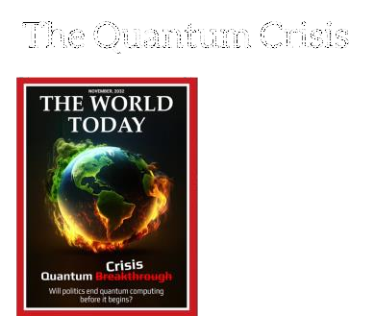
Geneva Science and
Diplomacy Anticipator Foundation
SSttrruuccttuurreeoofftthheeggaammee
How did we get there?
SDW | 13.06
January
2034
Februar y
2035
July
2035
November
2035
March
2034
May
2035
August
2035
December
2035

Slide 20
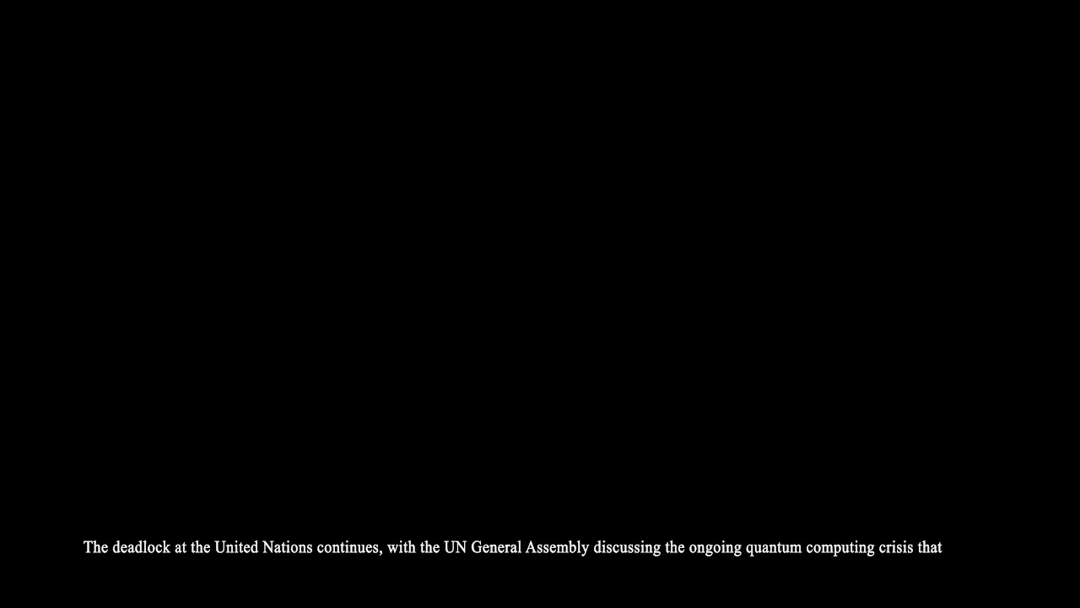
Geneva Science and
Diplomacy Anticipator Foundation
20
SDW | 13.06

Slide 21

How did we get there?
Geneva Science and
Diplomacy Anticipator Foundation
Structure of the_{H}g_{o}a_{w}me_{did we get there?}
SDW | 13.06
January
2034
Februar y
2035
July
2035
November
2035
March
2034
May
2035
August
2035
December
2035

Slide 22

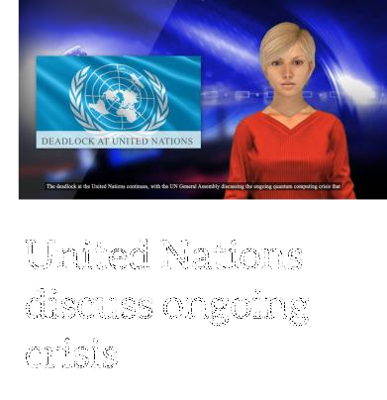
Geneva Science and
Diplomacy Anticipator Foundation
SSttrruuccttuurreeoofftthheeggaammee
How did we get there?
SDW | 13.06
January
2034
Februar y
2035
July
2035
November
2035
March
2034
May
2035
August
2035
December
2035

Slide 23















2035
Structure of the_{H}g_{o}a_{w}me_{did we get there?}
SDW | 13.06
Quantum computers
can address complex computationally tasks, solving
quantum
previously intractable problems. A few nation states have
computer systems operated by research institutions, but the technology is
still inaccessible for most .
NATION STATE – BRIA
A quantum computer
A novel material to capture
LICENSING AGREEMENT<> PROMISE
“implement for good of society”
Restricted good
greenhouse emissions, cheap
PRIVATE COMPANY – Medormar Corp
Februar
and scalable – PATENT
July
y▪
ENABLING TECHNOLOGY > HELI2U0M35
Expertise and production capability for the material
Distribution exclusivity
Export Control
2035(cooling system)
March
May
August
2035
Extremely high ^{D}MeA^{c}RK^{e}U^{m}P^{ber} on cost of produc2ti0o3n5
SOLTE
²⁰A³DV⁴OCATES for human-centred ²⁰³⁵
technology development
WAKKE
SEEKS to build the skills for quantum talent
CIVIL SOCIETY – NGOS and
Activists
CALL to remove patent for common good
LAUZE (Quantum Capability)
EXAMINES reverse engineering the material
WORLD METEOROLOGICAL ORGANIZATION
STATEMENT: “moral imperative for such carbon-mitigating technology to be shared as a Global Public Good”

Slide 24
Let’s rewind to 2025
THE GENEVA SCIENCE AND DIPLOMACY ANTICIPATOR USE THE FUTURE TO BUILD THE PRESENT
Geneva Science and
Diplomacy Anticipator Foundation

Slide 25
Use the future to build the present
THE GENEVA SCIENCE AND DIPLOMACY ANTICIPATOR USE THE FUTURE TO BUILD THE PRESENT
Geneva Science and
Diplomacy Anticipator Foundation

Slide 26
THE GENEVA SCIENCE AND DIPLOMACY ANTICIPATOR USE THE FUTURE TO BUILD THE PRESENT
Geneva Science and
Diplomacy Anticipator Foundation
Think creatively about the world you want to help create

Slide 27
Can you advance towards an agreement on...?
THE GENEVA SCIENCE AND DIPLOMACY ANTICIPATOR USE THE FUTURE TO BUILD THE PRESENT
Geneva Science and
Diplomacy Anticipator Foundation
◻ Intellectual property rights and regulation
How can we balance universal access with incentives for innovation?
⚖️ Ethics & social license?
How do we build awareness and societal acceptance for quantum technologies?
🌍 Scientific and cultural cooperation
How do we manage tensions over access, control, militarization, and dual-use risks?
☎ Hardware and supply chain access
How do we build resilient quantum computing infrastructure?
🔐 Security & weaponization
How do we prevent the misuse of quantum computing by rogue actors or in military contexts?
📚 Capacity building & brain drain
How do we build global capacity while preventing talent and data from concentrating in a few powerful countries?

Slide 28
Debriefing
THE GENEVA SCIENCE AND DIPLOMACY ANTICIPATOR USE THE FUTURE TO BUILD THE PRESENT
Geneva Science and
Diplomacy Anticipator Foundation
How should we govern technologies that have fundamental implications for our personal identity, autonomy, and responsibility? What are the social, ethical, political considerations?
What is the role of diplomacy in directing the development of neurotechnology towards beneficial use cases and avoid exacerbating divides and power imbalances?
How to balance innovation with regulation? What would ideal regulation look like?
Why is it important to think about long-term governance before science breakthroughs and their applications become widespread? How can we regulate before we know what a future technology might do?
How can multilateral institutions become more anticipatory and proactive in the governance of emerging technologies? What is the interplay between national and international governance?
What are the roles and responsibilities of the different stakeholders and communities
(researchers, governments, industry, philanthropy and publics) in this process?
How to protect researchers and operationalize the ‘right to science’ in the current geopolitical climate? While protecting citizens from the potential harms and risks derived from scientific innovations?

Slide 29

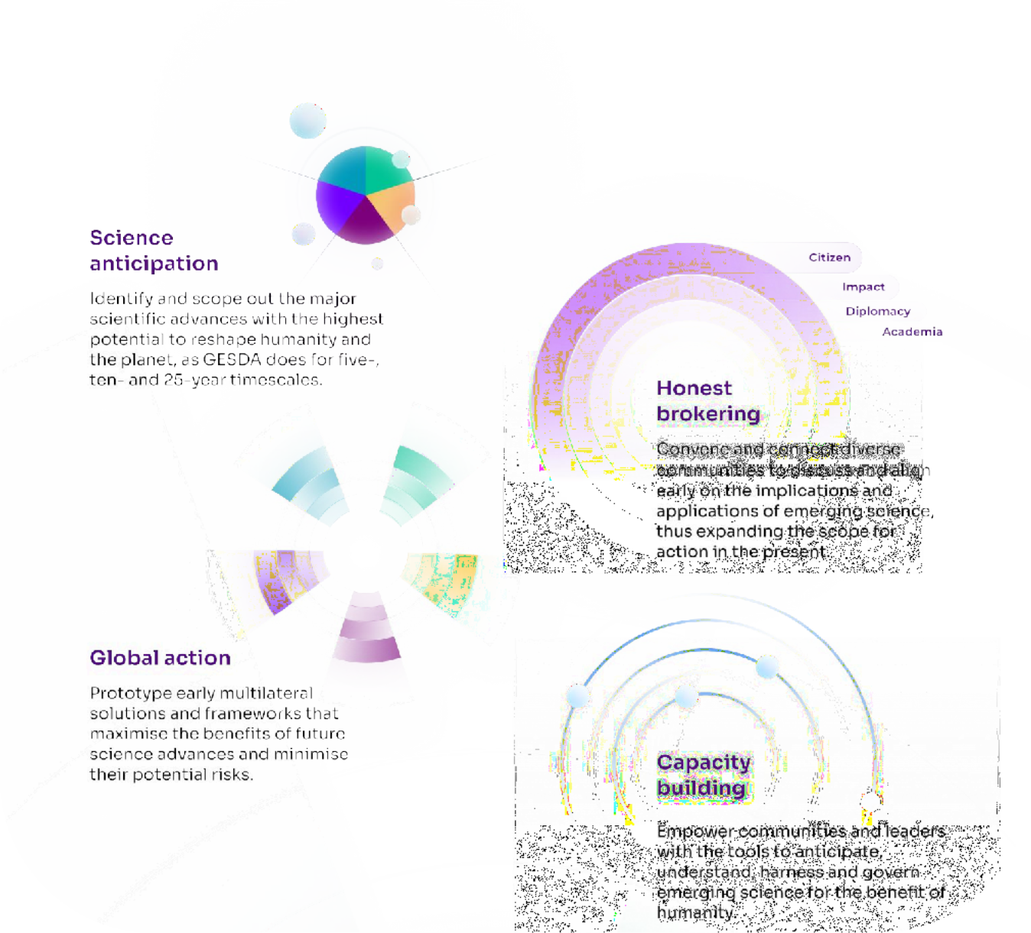
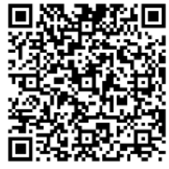
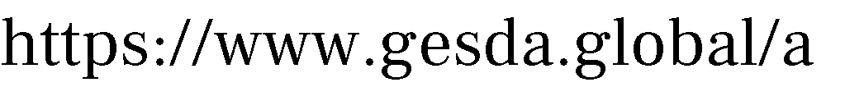










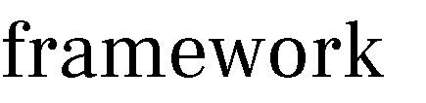

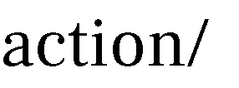
Navigating a new area marked by science breakthroughs and geopolitical tensions
THE GENEVA SCIENCE AND DIPLOMACY ANTICIPATOR USE THE FUTURE TO BUILD THE PRESENT
Geneva Science and
Diplomacy Anticipator Foundation

Slide 30

THE GENEVA SCIENCE AND DIPLOMACY ANTICIPATOR USE THE FUTURE TO BUILD THE PRESENT
Geneva Science and
Diplomacy Anticipator Foundation
Let’s
rewind

